Slide 1
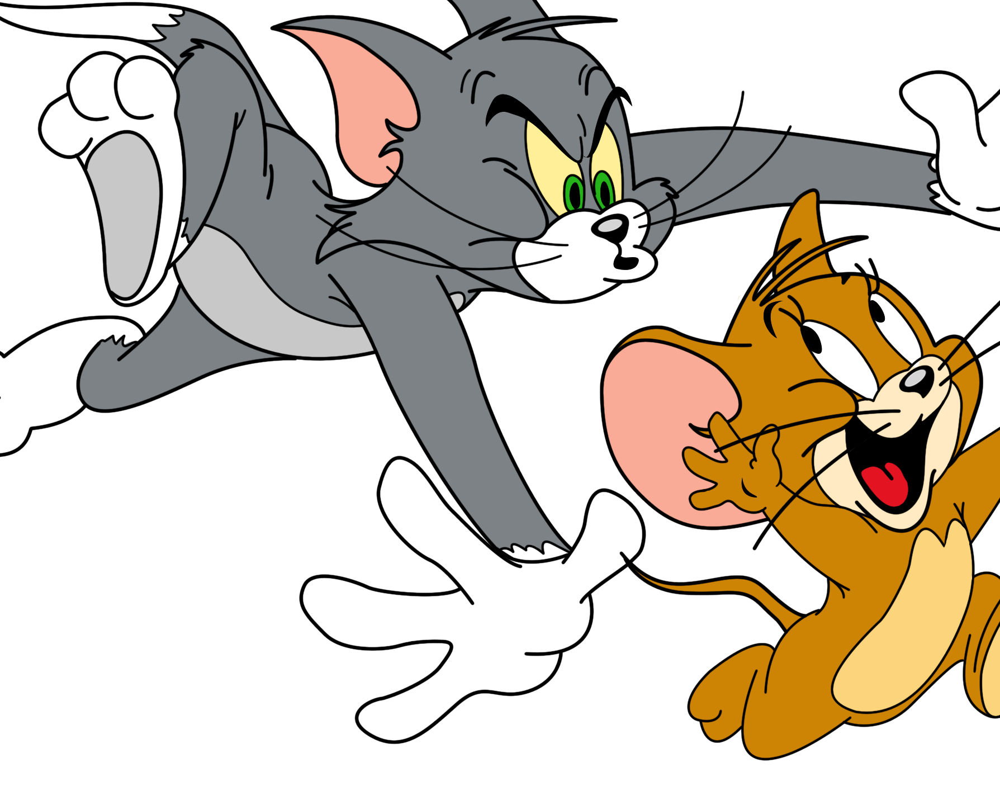
TeamAngio Tablut
Jasmin De Cecco
Matteo Di Lorenzi
Lorenzo Magnanelli
Mattia Mazzoli

Slide 2

BRIEF DESCRIPTION
Smart agent built to play Tablut with Ashton rules.
Bitboards: an efficient way to describe the state of the game.
Monte Carlo Tree Search (without the neural network part ☹).
Multithreading: tree parallelization allow us to takes full advantage of the available cores.

Slide 3
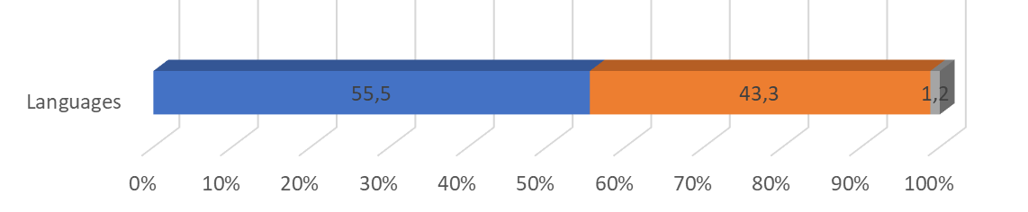
LANGUAGES
Python
Handle communication with server.
Convert java board into our state representation and viceversa.
Trigger state space search.
C
Efficient representation of the board.
Compute the possible legal moves.
Python
C
Other
Chart taken from our GitHub repository.

Slide 4
BITBOARDS
Inspired by Chess engines.
Bitboard as an array of three 32 bit integers.
Constant bitboards for castle, citadels and escape tiles.
Board as three bitboards: king, white and black pawns.
Implementation of bitwise operation and moves computation.
0 | 1 | 0 | 0 | 0 | 0 | 1 | 1 | 0
1 | 1 | 0 | 1 | 0 | 0 | 0 | 0 | 1
1 | 0 | 0 | 1 | 0 | 1 | 0 | 1 | 1
1 | 0 | 0 | 1 | 1 | 0 | 1 | 1 | 0
0 | 0 | 0 | 1 | 0 | 1 | 1 | 0 | 1
1 | 1 | 0 | 0 | 1 | 1 | 0 | 1 | 0
0 | 1 | 0 | 1 | 0 | 1 | 0 | 0 | 1
0 | 0 | 1 | 1 | 0 | 1 | 0 | 0 | 1
0 | 1 | 1 | 0 | 0 | 1 | 1 | 1 | 0
01000011 01101000 01100101 01110011
01100001 01101110 01101001 01010010
01101001 01100111 01101000 01110100

Slide 5
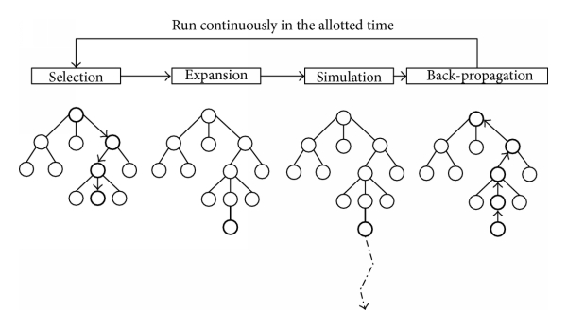
MONTE CARLO TREE SEARCH
Inspired by AlphaZero.
Monte Carlo consists in:
Selecting: select the node that has the
highest possibility of winning;
Expanding: node expantion from the
selected one;
Simulating: play a game of completely random decisions until it reaches a terminal state (win, lose, draw or simulation cap reached) and return a score of how well it performed;
Updating: propagate the results through the tree.

Slide 6
HEURISTIC & MULTITHREADING
Simple heuristic, the same for both black and white.
Count of how many times the node n is visited. (a)
Count of how many times win condition is reached passing through node n. (b)
Heuristic: b/a. The higer the better.
Root parallelization in order to perform MTCS on every available core.
No use of locks
No synchronization problems
search
collect the trees
return the best move
(among all of them)

Slide 7
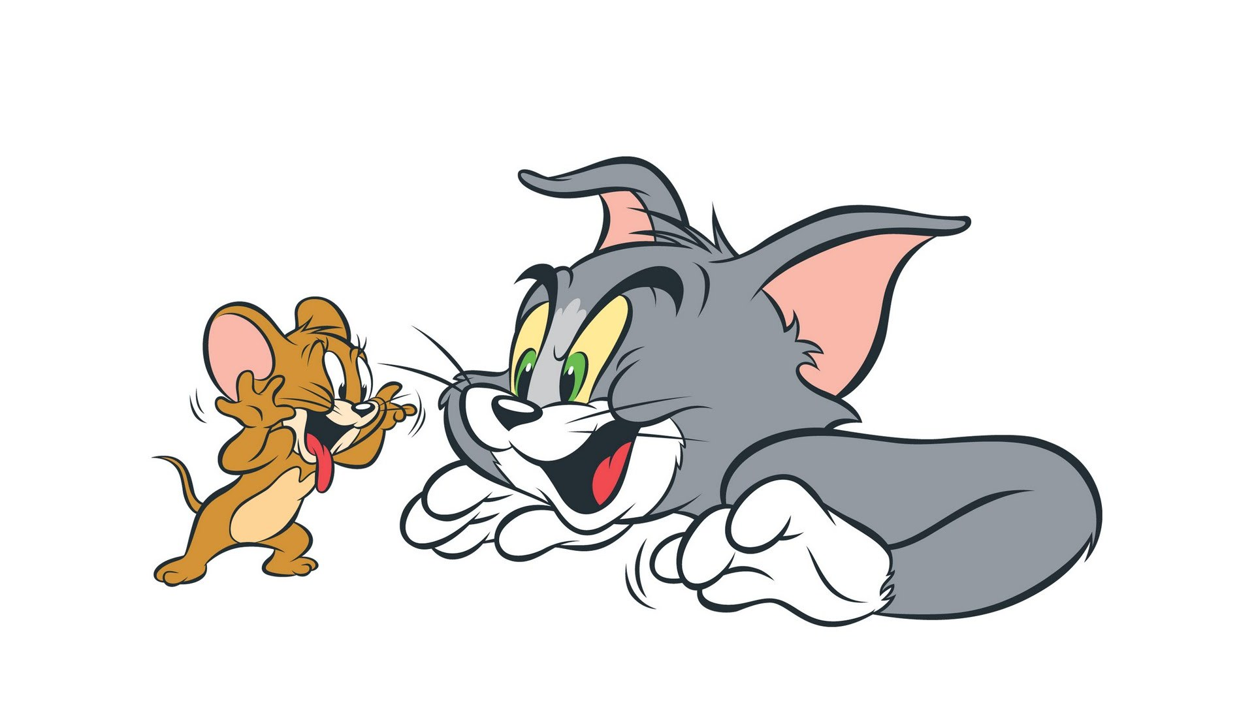
FUTURE IMPROVEMENTS
Better heuristics
Neural networks in order to gauge the best state (Reinforcement Learning as AlphaZero)
Root reuse

Slide 8
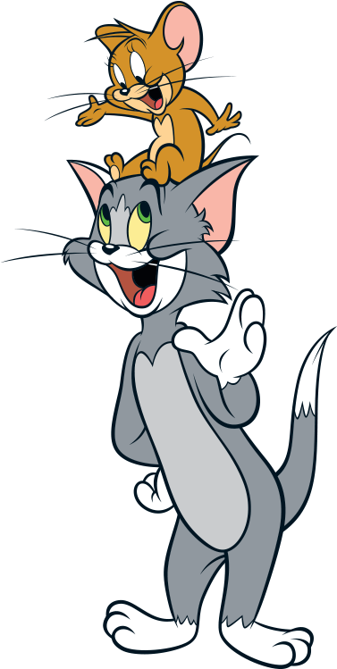
THANK YOU!

